Slide 1
Healthy Habits Portfolio
Grade 5

Slide 2
Your Driving Question
How can we stay healthy during puberty?

Slide 3
Feelings Tracker
Feeling | Rating
1 | I feel down
2 | I feel a bit down
3 | I feel so-so
4 | I feel good
5 | I feel great
Follow the steps to edit the chart:
Click on the chart
Click on ”Chart Design”
Click on “Edit Data in Excel”

Slide 4
Week 1
Follow these steps to complete this page:
After filming your activity, download your activity video from Teams
Click on the film icon to add your video to this PPT
Answer the questions
What activity did you pick?
??
Why did you pick this activity to improve your physical wellness?
??
Click on the film icon to put in your video

Slide 5
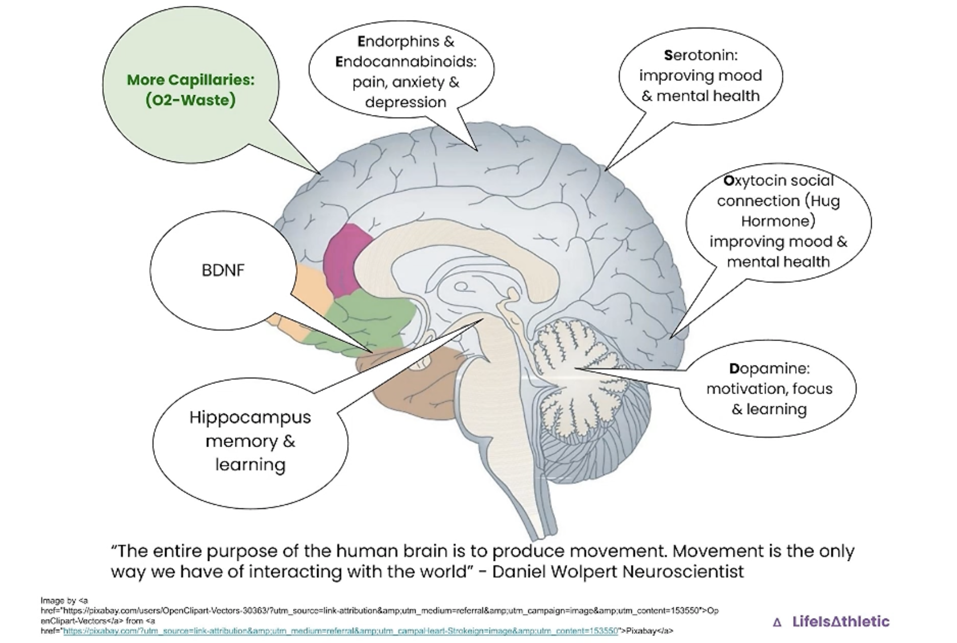
Week 2
Follow these steps to complete this page:
After filming your activity, download your activity video from Teams
Click on the film icon to add your video to this PPT
Answer the questions
Why is your activity considered exercise?
??
Look at the picture of the brain, how does your activity improve the brain?
??
Click on the film icon to put in your video

Slide 6
Week 3
Follow these steps to complete this page:
After filming your activity, download your activity video from Teams
Click on the film icon to add your video to this PPT
Answer the questions
Read the image above, what does it tell you?
??
Click on the film icon to put in your video

Slide 7
Week 4
Follow these steps to complete this page:
After filming your activity, download your activity video from Teams
Click on the film icon to add your video to this PPT
Complete the reflection on the final page
Click on the film icon to put in your video

Slide 8
Health and Fitness Reflection
Choose 3 parts of the Meaningful PE framework to reflect on the unit.

