Slide 1
Healthy Habits Portfolio
Grade 5

Slide 2
Your Driving Question
How can we stay healthy during puberty?

Slide 3
Feelings Tracker
Feeling | Rating
1 | I feel down
2 | I feel a bit down
3 | I feel so-so
4 | I feel good
5 | I feel great
Follow the steps to edit the chart:
Click on the chart
Click on ”Chart Design”
Click on “Edit Data in Excel”

Slide 4
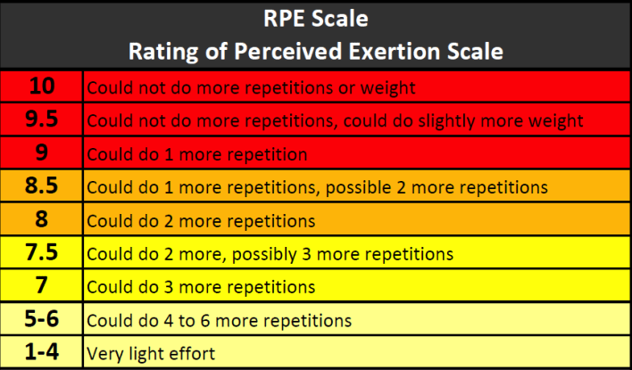
Week 1
Follow these steps to complete this page:
Write down the exercises as you train
Record the weight, the number of sets, reps, and how long you rested for
Answer the questions below
What activity did you pick?
??
Exercise | Weight | Sets | Reps | Rest | RPE
Why did you pick this activity to improve your physical wellness?
??
Fill in your training log above

Slide 5
Week 2
Follow these steps to complete this page:
Write down the exercises as you train
Record the weight, the number of sets, reps, and how long you rested for
Answer the question below
Exercise | Weight | Sets | Reps | Rest
Look at the picture of the brain, how does your activity improve the brain?
??
Fill in your training log above

Slide 6
Week 3
Follow these steps to complete this page:
Write down the exercises as you train
Record the weight, the number of sets, reps, and how long you rested for
Answer the question below
Exercise | Weight | Sets | Reps | Rest
Read the image above, what does it tell you?
??
Fill in your training log above

Slide 7
Week 4
Follow these steps to complete this page:
Write down the exercises as you train
Record the weight, the number of sets, reps, and how long you rested for
Answer the question below
Analyze the data from your training log. Have you noticed any changes? If so, what changes can you see?
??
Exercise | Weight | Sets | Reps | Rest
Fill in your training log above

Slide 8
Health and Fitness Reflection
Choose 3 parts of the Meaningful PE framework to reflect on the unit.

